Slide 1
Updates on HPC and Data management at NCI
Dr. Ben Evans
Associate Director, REI
National Computational Infrastructure (NCI) Australia

Slide 2

Major ACCESS and related codes analysed
ACCESS APS2 (Global, Regional, City) | ACCESS-CM2 | ACCESS-S1
ACCESS-OM | UM 10.6/7 N512, N728, N1024, N1280 | WRF
MOM5 0.25, 0.1 (inc CICE5 and SIS1) | MOM6 | NEMO 0.25
4DVAR N216, N320 | EnKF-C | BODAS
GC2 | GC3 | GITM
WaveWatch3 | NOAA MOST | ROMS
Common HPC profiling methodology across all elements: CPU and memory, performance, decomposition, interprocessor communication, IO
Evaluation against system roofline measures
Evaluation on new computational technologies (e.g., new accelerator technology)
ACCESS Reference configurations for community registered in access-dev.nci.org
© NCI Australia 2017
ACCESS Science Day. Ben Evans

Slide 3
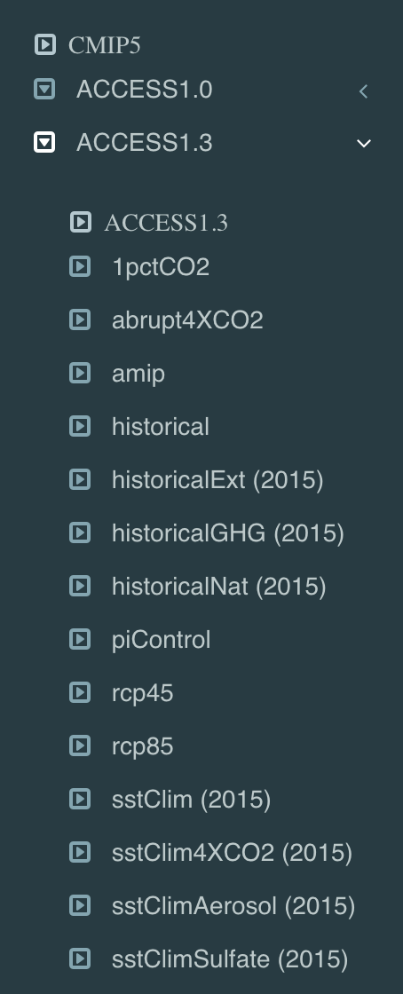
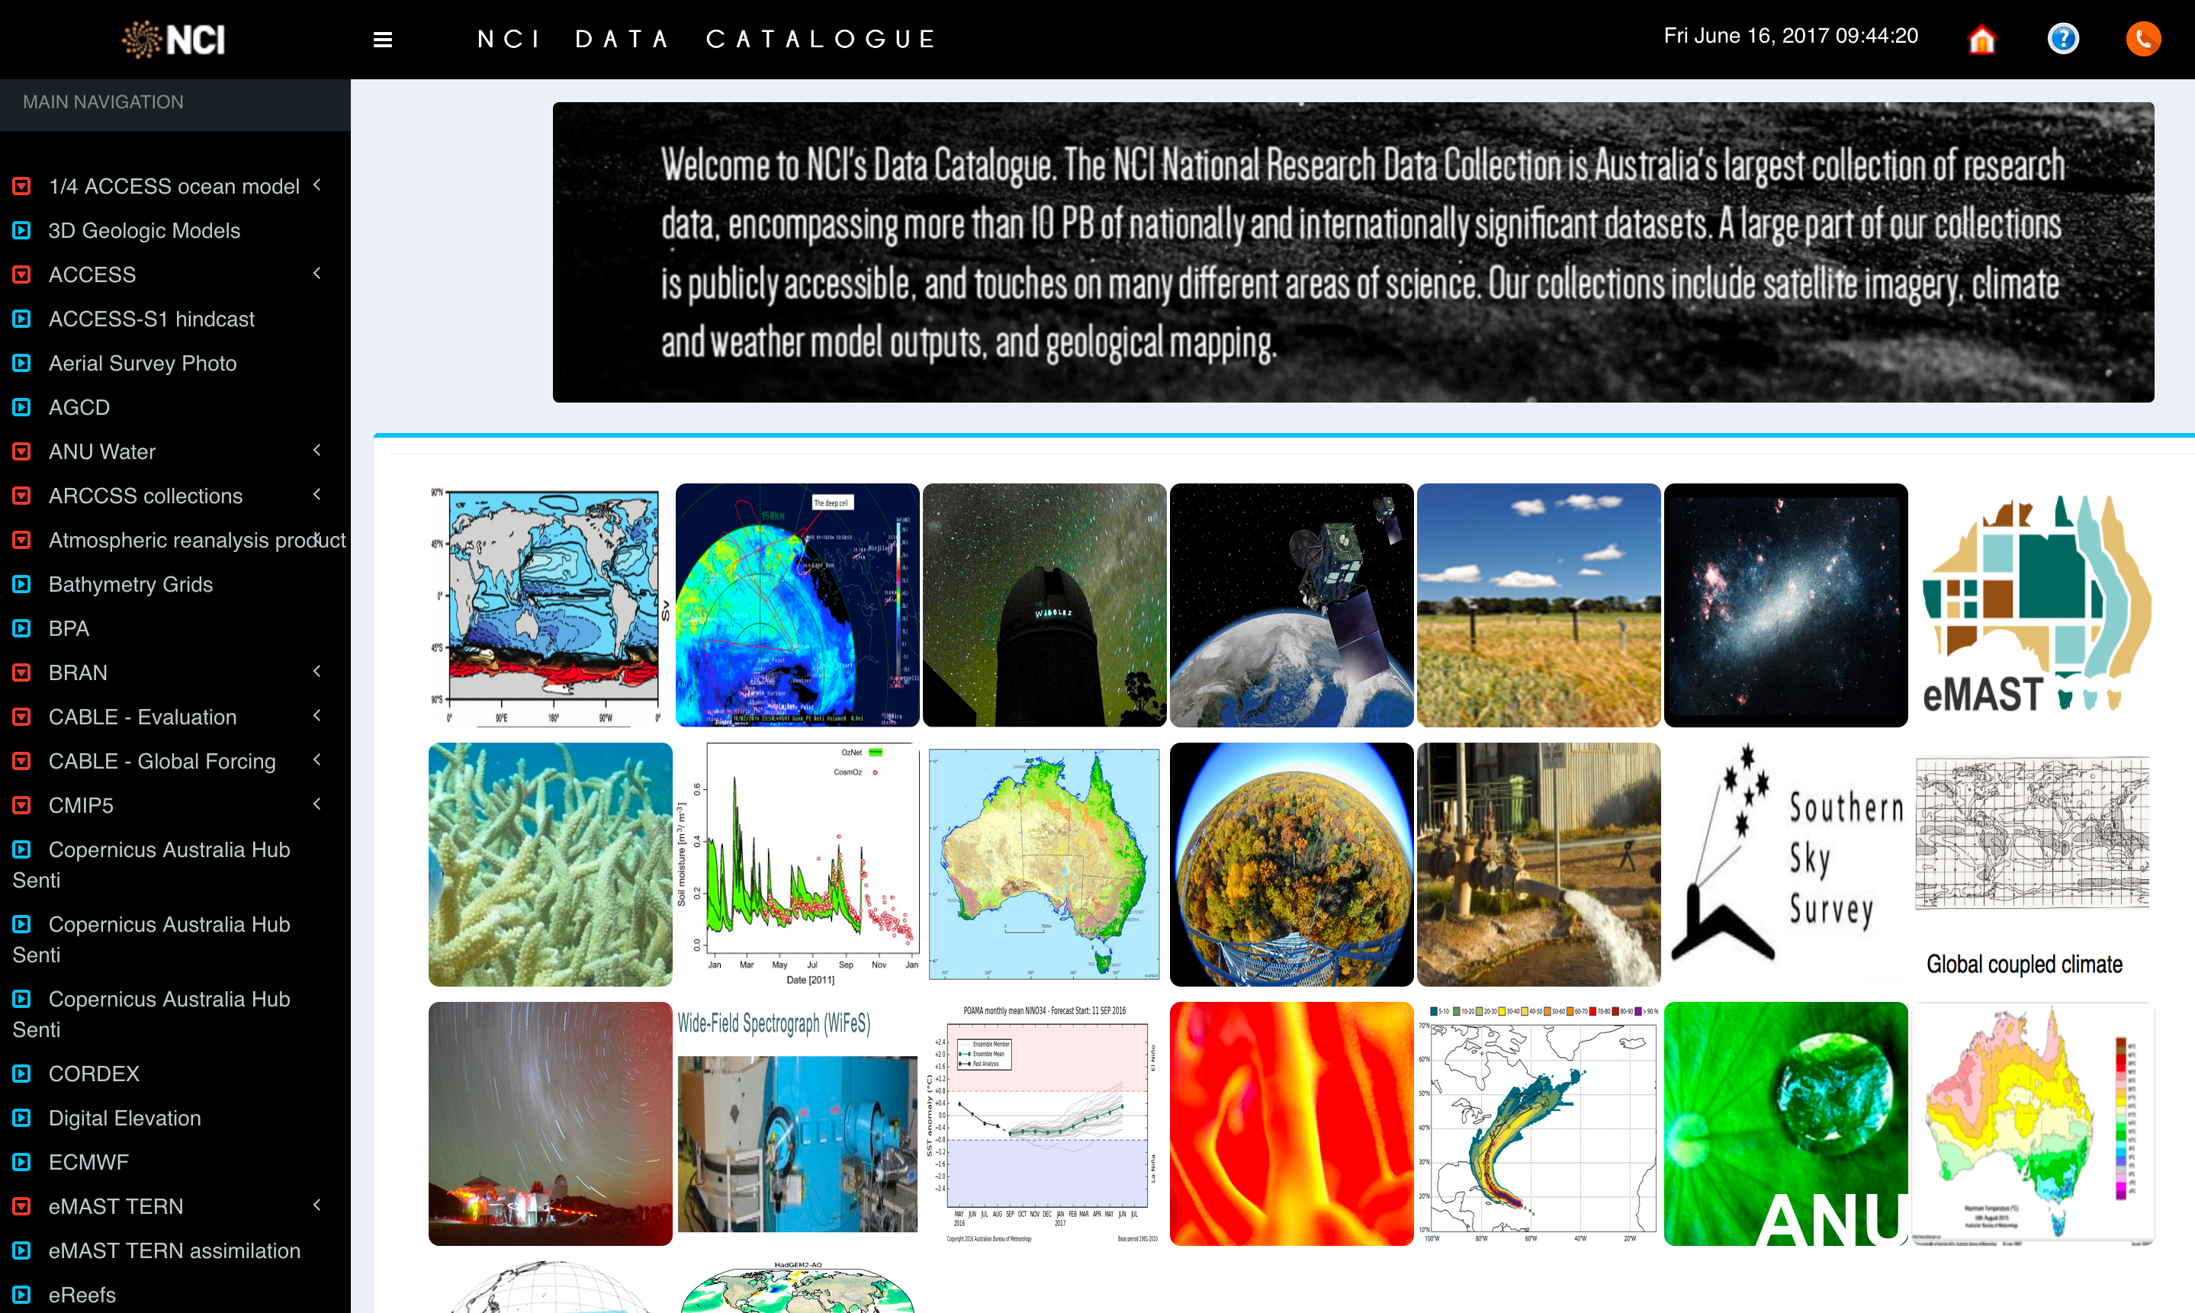
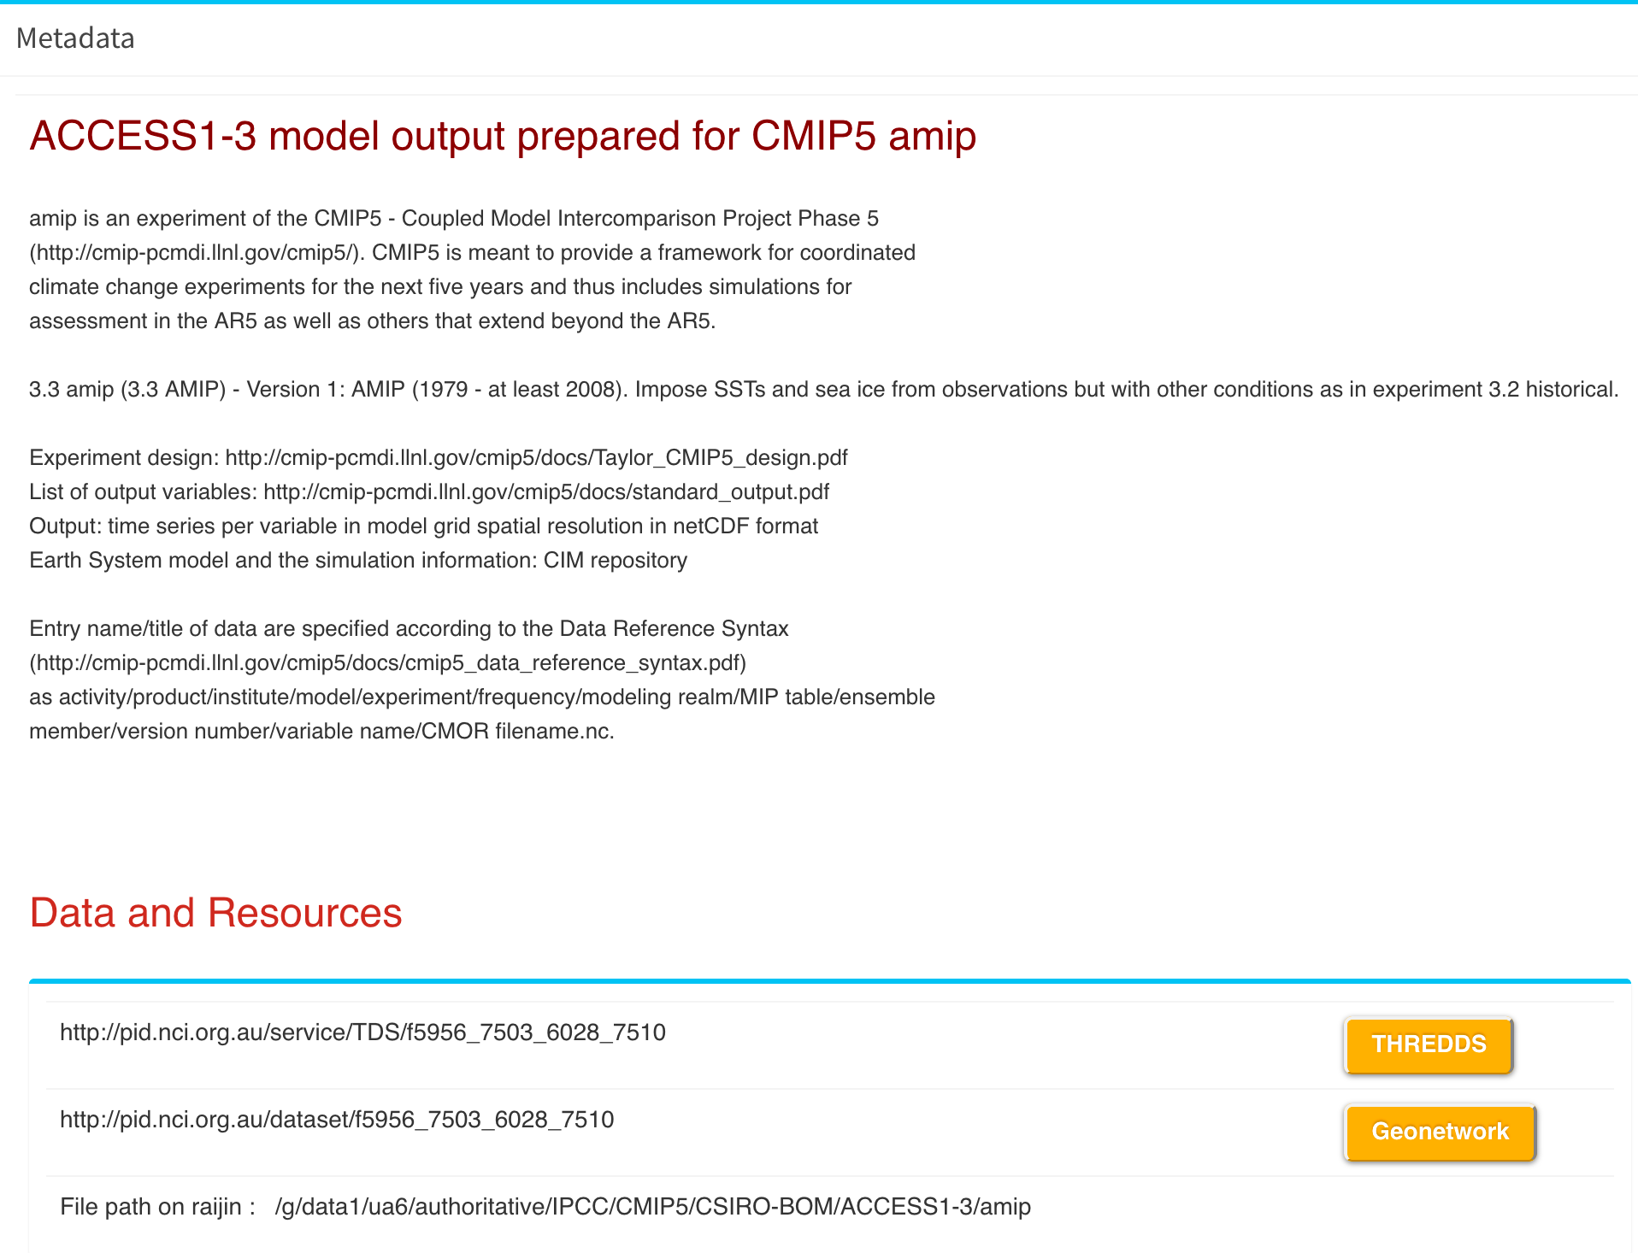
Climate and Weather Datasets within NCI Discovery portal
* Datasets catalogue entries
* Queries of the data catalogue
* Data access for each dataset (download and metadata review)
* Data is quality tested (metadata specifications, functionality, and usability within community applications)
Usage tracking that rely on the datasets and data services (nationally and internationally)
~4,000 unique users per quarter:
50M queries
20-50 Tbytes accessed via data services
1. Climate/ESS Model Assets and Data Products
2. Earth and Marine Observations and Data Products
3. Geoscience Collections
4. Terrestrial Ecosystems Collections
5. Water Management and Hydrology Collections
https://datacatalogue.nci.org.au
© NCI Australia 2017
ACCESS Science Day. Ben Evans

Slide 4
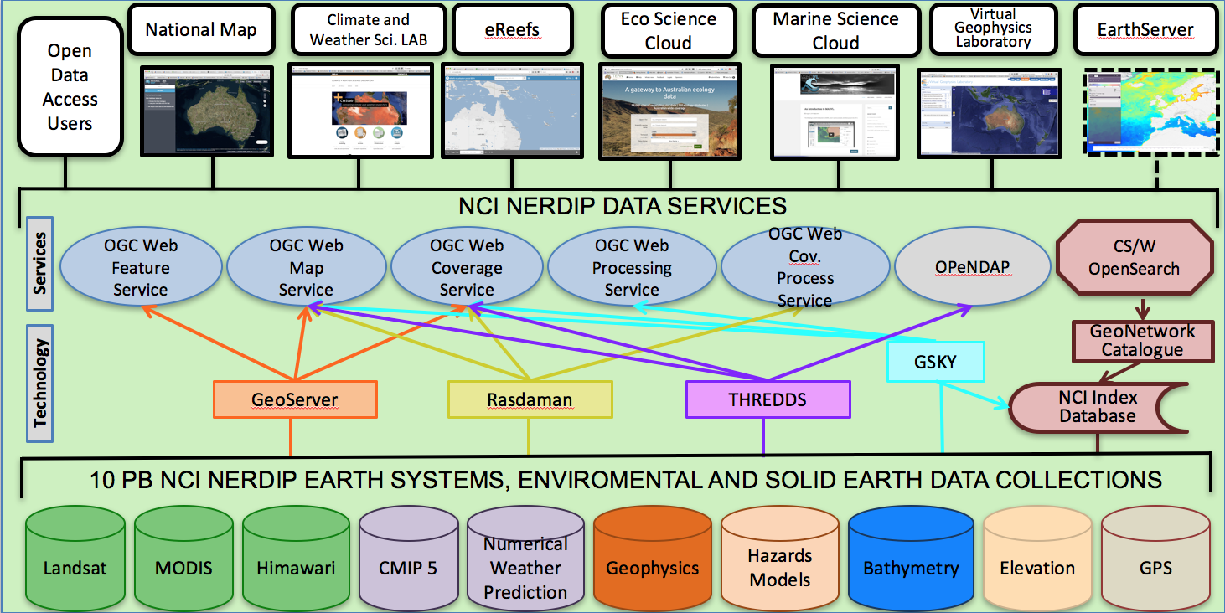

NCI Data Publishing Service Architecture
Standards-compliant
Community-compliant
Third-party implementations
NCI custom implementations
Data also accessed via Raijin NCI VDI (Virtual Desktop Interface)
ACCESS-dev integrated into NCI cloud
CMIP, CORDEX at NCI will be published with both NCI standard services and ESGF
Project for automated dataset (variable level) replication service (ESGF, BOM, ECMWF, …)
Some upcoming changed directory layouts for data (particularly CMIP) but also other collections.
© NCI Australia 2017
ACCESS Science Day. Ben Evans

Slide 5
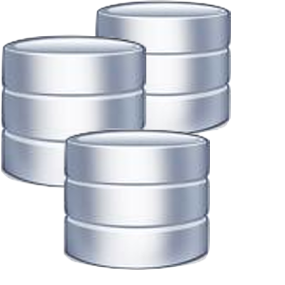




NCI New attribute level discovery
NCI Metadata Attribute Service:
Nightly Indexing NCI /g/data
POSIX, Buckets
Checksummed data
ESGF Solr (federation)
OpenSearch
Reporting
/g/data
Raijin
Tenjin
S3
EC2
NCI
© NCI Australia 2017
ACCESS Science Day. Ben Evans

Slide 6


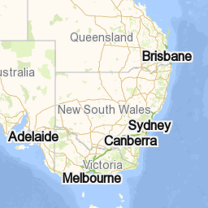
New Services: ARCCSSive (MkII)
MAS
/g/data
NetCDF Crawl
CMIP
ARCCSSive
© NCI Australia 2017
ACCESS Science Day. Ben Evans

